Slide 1


K.RAMAKRISHNAN COLLEGE OF TECHNOLOGY
(AUTONOMOUS), TRICHY
MOVIE TICKET BOOKING SYSTEM
PRESENTED BY SUPERVISOR
SUBASH R Ms.S.Uma Maheswari M.E.,
2303811720521052 AP/CSE.

Slide 2
PRESENTATION OVERVIEW
Objective
Project Introduction
Problem Statement
Methodologies (Programming concepts relevant to problem statement)
Architecture of the proposed system
List of Modules
7. Merits
8. Results and Discussion
9. Queries

Slide 3
OBJECTIVE
To design and develop an efficient movie ticket booking system that allows users to select movies, choose seats, and manage bookings seamlessly while maintaining user-friendly interfaces and accurate booking history.

Slide 4
PROJECT INTRODUCTION
The Movie Ticket Booking System is a user-friendly software application designed to simplify the process of reserving movie tickets. This system enables users to create accounts, log in, browse available movies, select seats, and make payments securely. It also maintains a detailed booking history for users to track their past reservations. By integrating essential features such as movie listings, seat selection, and payment gateways, the system provides a seamless and efficient booking experience, reducing the need for manual ticket purchasing and enhancing customer convenience.

Slide 5
PROBLEM STATEMENT
The Movie Ticket Booking System aims to develop an efficient, user-friendly platform for booking movie tickets online. It provides functionalities for user registration, login, browsing movies, seat selection, payment processing, and booking history management. The project seeks to streamline the ticket booking process, minimize errors, enhance user convenience, and deliver a seamless entertainment experience through automation and intuitive design.

Slide 6
METHODOLOGIES
1. Object-Oriented Design (OOD): Utilizing classes, objects, and modular architecture for better reusability and scalability.
2. Event-Driven Development: Capturing and responding to user actions using listeners (e.g., button clicks).
3. Iterative Development: Incremental implementation and testing of features for step-by-step improvement.
4. User-Centered Design: Designing the interface and functionality to focus on user needs and usability.

Slide 7
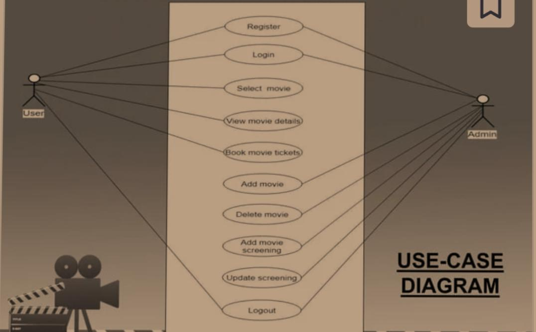
ARCHITECTURE OF THE PROPOSED SYSTEM

Slide 8
LIST OF MODULES
1. User Authentication
Handles login/signup functionality and stores user credentials.
2. Movie Selection
Displays movies with pricing and allows users to choose a movie.
3. Seat Selection
Provides a seat selection interface and calculates total cost based on selected seats.
4. Payment
Displays payment details and processes bookings.
5. Booking History
Tracks and shows previous bookings, including movie, seats, and total cost.

Slide 9
MERITS
1. User-Friendly Interface: Easy navigation for users.
2. Secure Login: Safe user authentication.
3. Real-Time Price Calculation: Instant cost updates based on seat selection.
4. Booking History: Tracks past bookings for users.
5. Modular Design: Flexible for future updates.
6. Error Handling: Ensures smooth user experience.
7. Efficient Data Management: Quick data retrieval and updates.

Slide 10
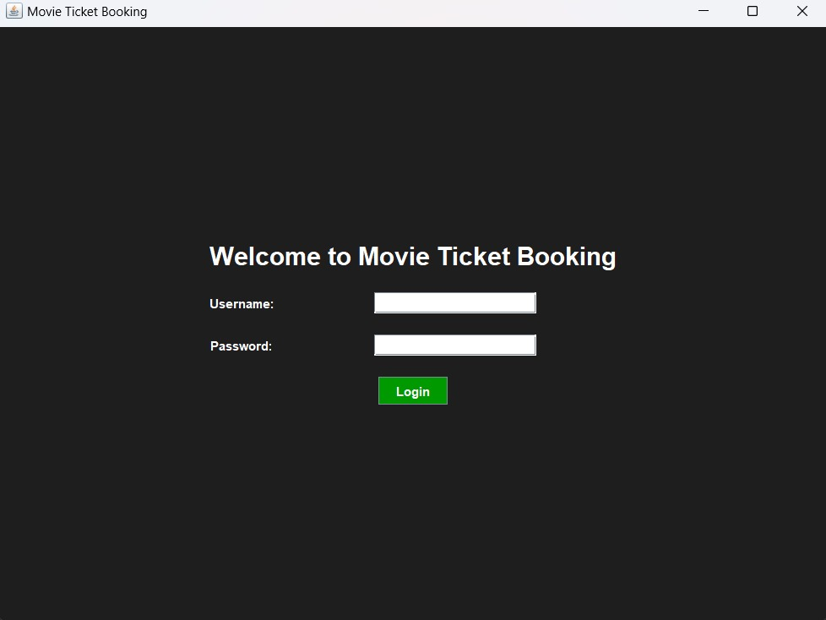
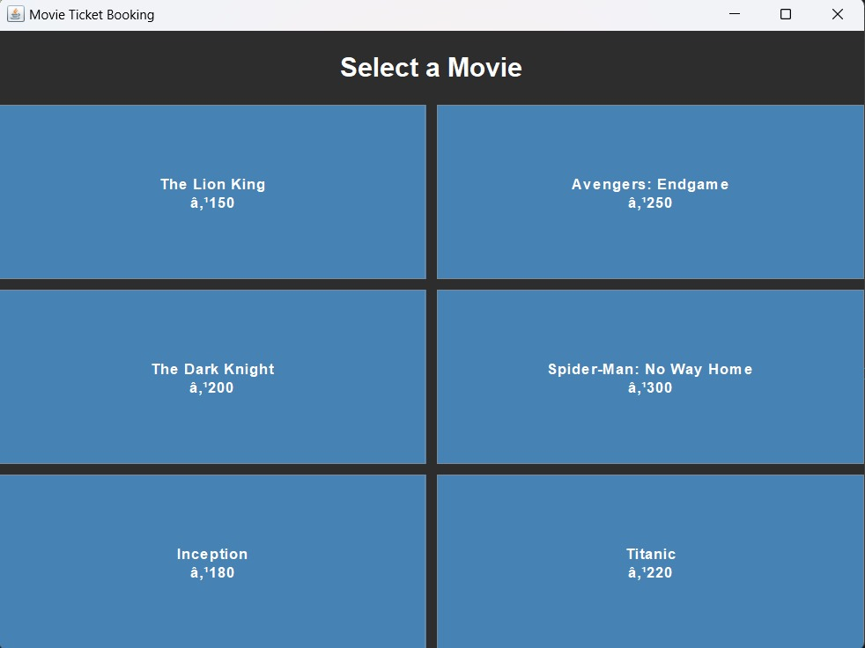
RESULTS AND DISCUSSION

Slide 11
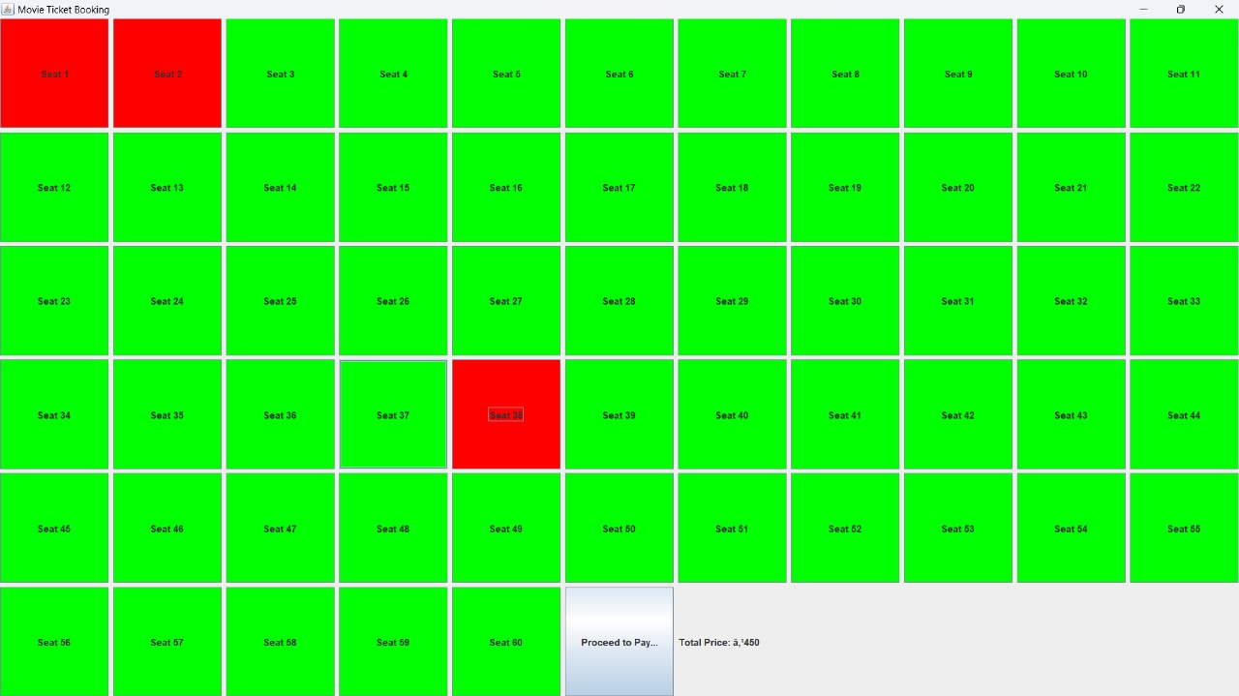
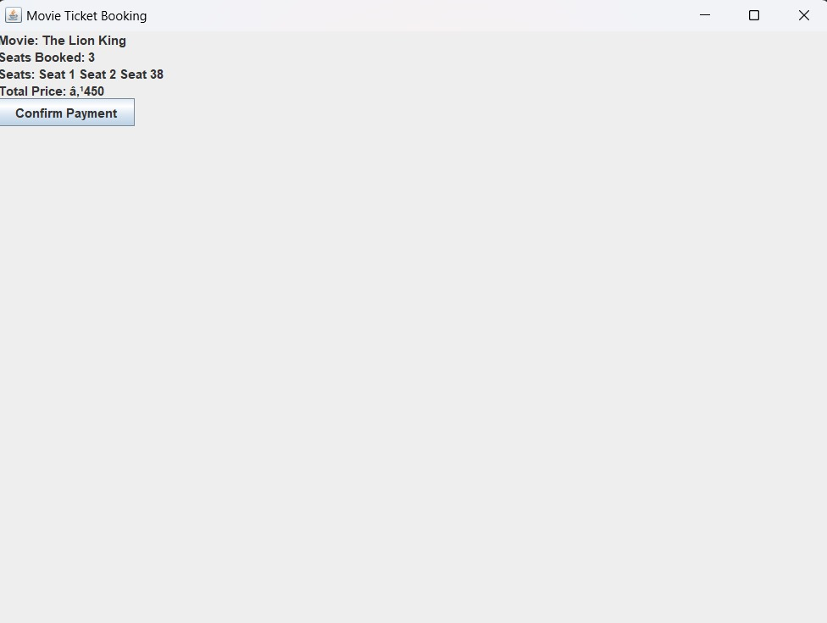
RESULTS AND DISCUSSION

Slide 12
QUERIES
ANY QUERIS?

